Slide 1
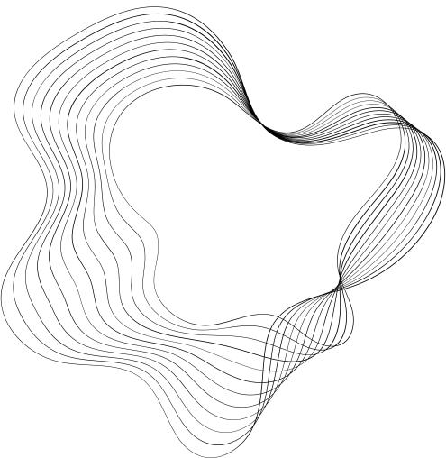



CSE431
NAME: ADHARA LABANNYA
ID: 20101260
adhara.labannya@g.bracu.ac.bd
TOPIC
USING LEXICAL FEATURES FOR MALICIOUS URL DETECTION
A MACHINE LEARNING APPROACH
THANK YOU TO THE ST AND RA MEHNAZ ARA FAZAL & ADIB MUHAMMAD AMIT
01

Slide 2

TABLE OF CONTENT
TOPICS
Slide No.
03
THE PHISHING THREAT: WHY URL DETECTION MATTERS
04
MACHINE LEARNING WITH LEXICAL FEATURES
05
BUILDING THE DETECTION ENGINE: A SYSTEMATIC PROCESS
06
REAL-WORLD IMPACT: DEPLOYMENT AND RESULTS
07
LIMITATIONS AND FUTURE RESEARCH: REFINING THE SYSTEM
08
BEYOND URLS: BROADER APPLICATIONS
02

Slide 3





THE PHISHING THREAT:
WHY URL DETECTION MATTERS
Rising cyberattacks highlight the need for robust URL detection strategies.
Blacklists and heuristics have
<- limitations ->
HIGH FALSE POSITIVES/NEGATIVES, IMPACTING USER EXPERIENCE
STATIC AND EASILY BYPASSED BY ATTACKERS
03

Slide 4




MACHINE LEARNING WITH LEXICAL FEATURES
This research proposes a Machine Learning ensemble classification method
Utilizing static lexical features extracted from URLs.
These features capture characteristics indicative of malicious intent (e.g., keywords, unusual characters).
CLASSIFICATION METHOD
CAPTURING CHARACTERISTICS
KEY INNOVATION
04

Slide 5




BUILDING THE DETECTION ENGINE
A SYSTEMATIC PROCESS
The study follows the Crisp-DM process model:
Business Understanding
Data Understanding
Data Preparation
Data Modeling
Collaboration
Innovation
Training and evaluating the Random Forest classifier based on lexical features.
Analyzing the need for accurate and scalable URL detection
Exploring datasets and identifying relevant features.
Cleaning and pre-processing URL data.
05

Slide 6



REAL-WORLD IMPACT
Deployment
The model was successfully integrated into FireEye Advanced URL Detection Engine (FAUDE).
Results
Significant improvement:
22% increase in malicious URL detection compared to existing methods. Demonstrates the practical effectiveness and potential of the lexical feature approach.
06

Slide 7
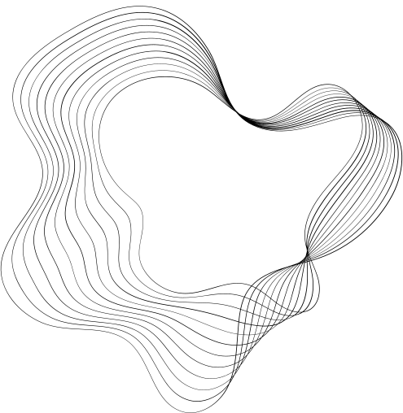

Limitations and Future Research
Refining the System
05
The study acknowledges the need for trade-offs between
MODEL SIZE
Smaller models are faster but potentially less accurate.
FUTURE RESEARCH
LATENCY
Investigating specific limitations and vulnerabilities of the model. Optimizing trade-offs for real-world performance. Exploring the impact on different URL formats and attack techniques.
Real-time detection requires fast response times.
FALSE NEGATIVE RATE (FNR)
Avoiding missed threats
07

Slide 8
BEYOND URLS
BROADER APPLICATIONS
The potential to adapt the model for detecting malicious URLs in other mediums:
Text messages
Advertisements
Phishing emails
08

